Slide 1
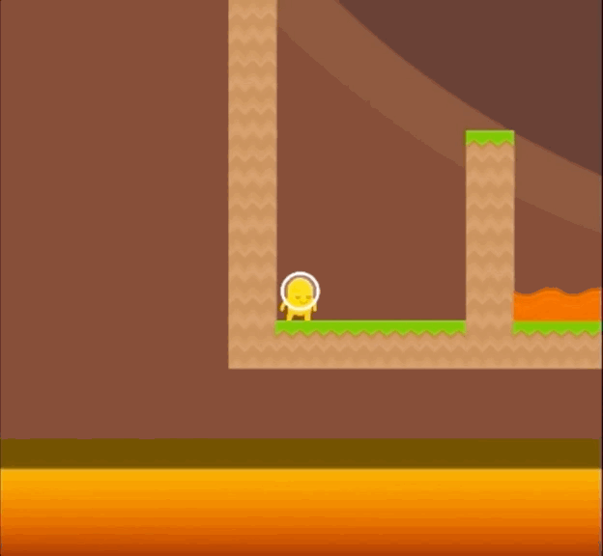

Quantifying Generalization in Reinforcement Learning
Karl Cobbe, Oleg Klimov, Chris Hesse, Taehoon Kim, John Schulman
December 6, 2018
Presented By: Sunil Kumar
Notes:
I will be presenting the paper by people at OpenAI “Quantifying Generalization in Reinforcement Learning” .

Slide 2
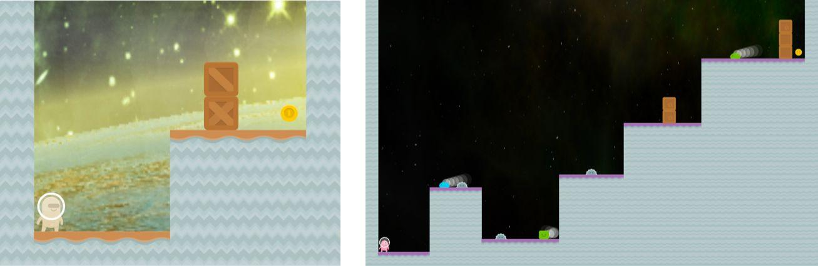
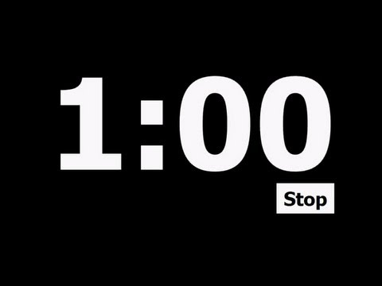
The Work
Generalization in RL
RL agents are still benchmarked by evaluating on the environments they trained on.
Simple Environment - Coinrun
Procedurally Generated/Random Maps
Customizable Difficulty
Explore
Major RL policies are often trained without supervised learning techniques such as dropout and batch normalization.
Notes:
So the problem they want to study is that all RL algos are benchmarked by training and testing on the same environments. For example, agent trained to play 5 lvl of mario will perform very bad at 6th lvl even when the level is very similar due to overfitting.
Also they want to explore techniques like dropout and batch norm. Which are common in supervised learning but not used in RL.
They create a simple environment called Coinrun where the sole goal of the agent is to collect the coin at the end of the level to get a +ev reward. This environment can create million of different levels.

Slide 3
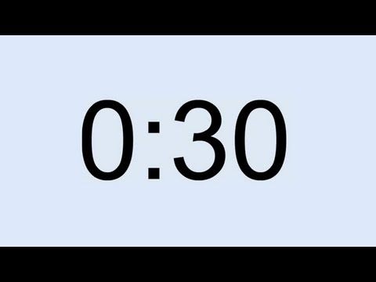
Main contribution of this paper
1. Number of different training levels required for good generalization is much larger than the number used by prior work on transfer in RL.
2. Generalization metric using the CoinRun environment.
3. They evaluate the impact of different convolutional architectures and methods of generalization.
Notes:
So, the main contribution by this paper includes a generalization metric using CoinRun. And they showed that number of training lvls required to train a good agent is much higher than lvls used in previous works. Also they evaluate the impact of different architectures and methods of generalizations.

Slide 4
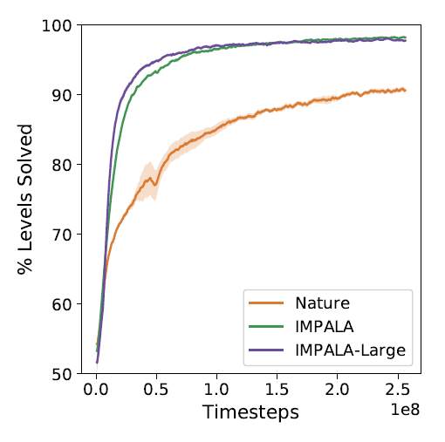
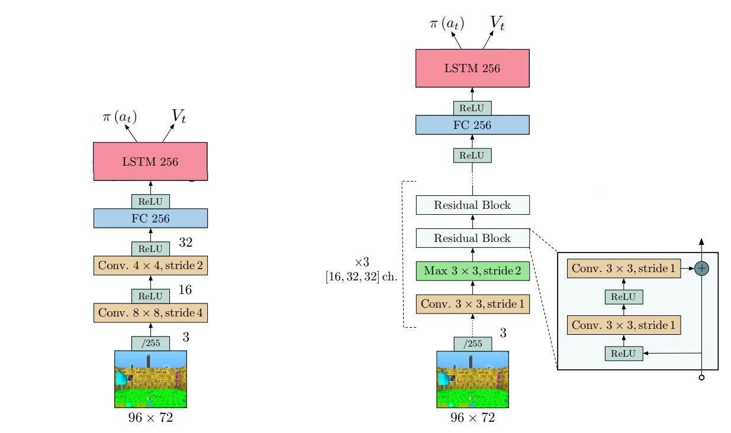
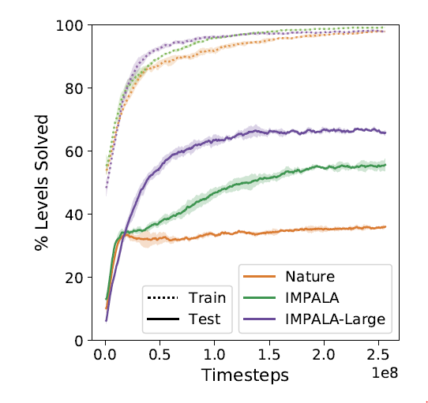
Nature-CNN (common 3-layer conv.)
IMPALA & IMPALA Large (5 residual blocks)
IMPALA: Scalable Distributed Deep-RL with Importance Weighted Actor-Learner Architectures, Lasse at. al. June 2018.
Human-level control through deep reinforcement learning. Volodymyr Mnih at. al. Feb 2015
Notes:
First of all they tested 3 different architectures. Nature-CNN is a simple 3 conv. Layers followed by 1 linear layer architecture, it is the same used by deepmind to play Atari 2600 games. IMPALA is one of the recently proposed architecture with configurable residual block. Note they did not use the LSTM note for Coinrun.
We can see the Large IMPALA which consist of 5 residual blocks performed significantly well. For further experiment they use Simple IMPALA as baseline.

Slide 5
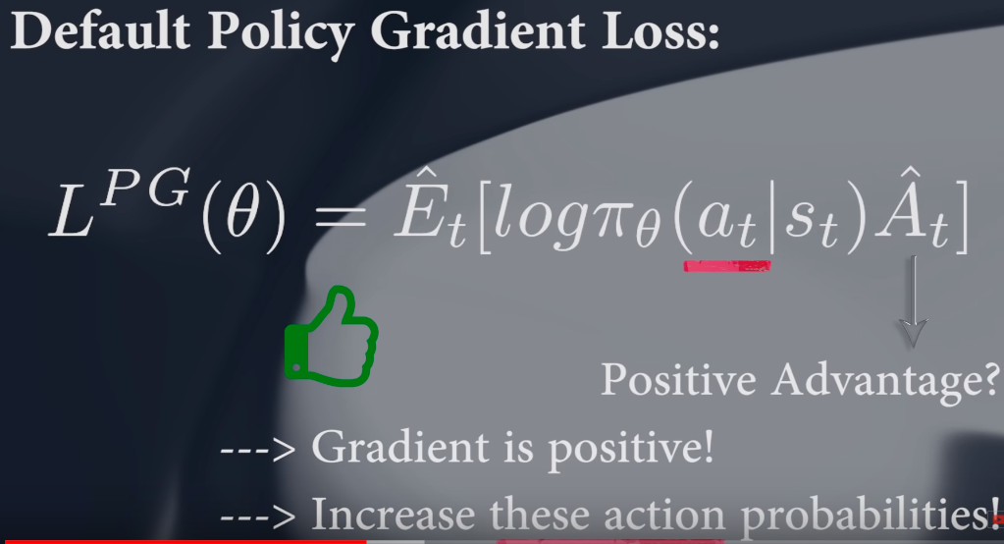
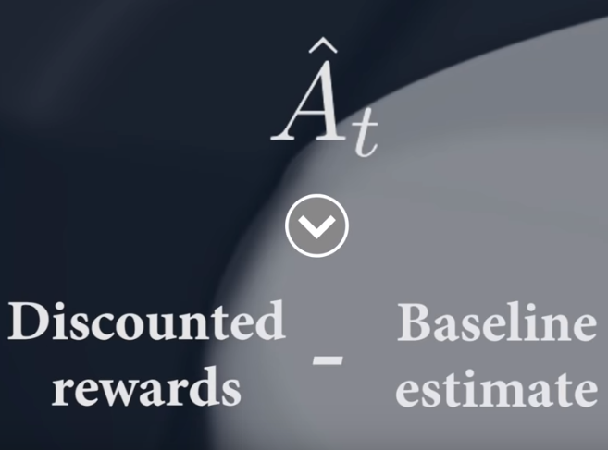
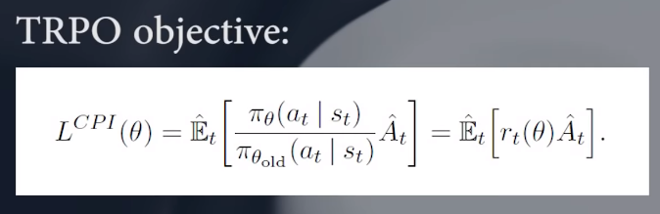
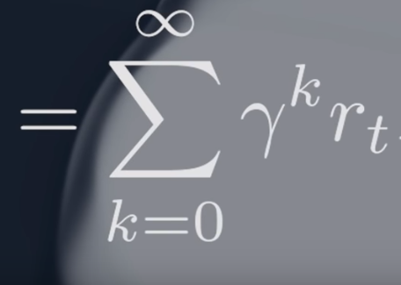
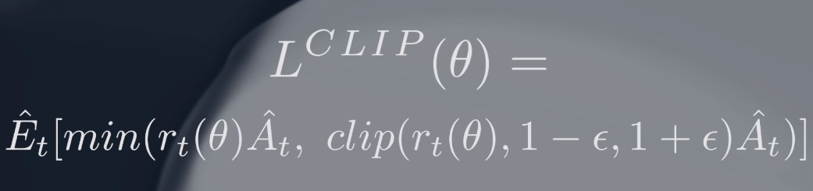
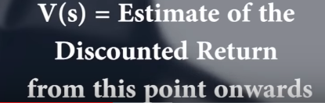
Proximal Policy Optimization (PPO)
TRPO (2017) -> PPO (2nd half 2017) -> TRPPO (2019)
Notes:
Here comes the maths, First of all we have studied that Model free RL algo can be majorly categorised as Q-Learning and Policy Gradient method.
So, they used a improved version of Policy Gradient methods known as Proximal Policy Optimization i.e. PPO. which basically learn only if the new policy learning is within the range of old learning else it drops the experience and try with next batch. Its a improvement on TRPO but it seems to find local minima in some cases so recently people have suggested TRPPO also in jan 2019. Btw if you want me to be more accurate about it they use PPO2 which is GPU optimized version of PPO.

Slide 6
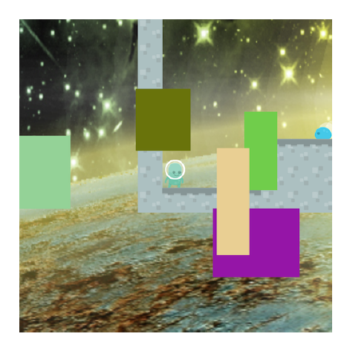
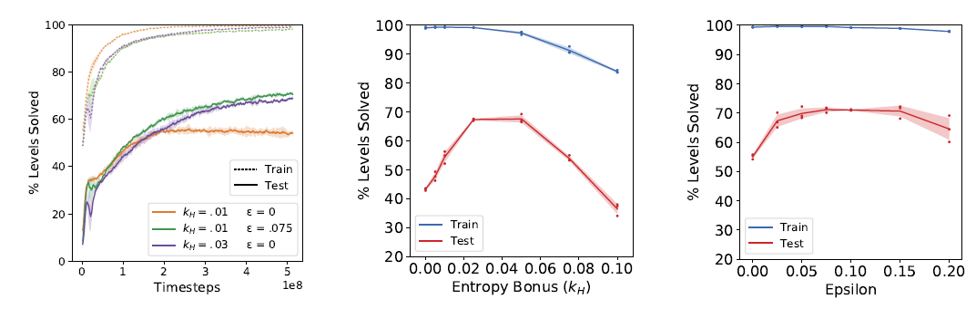
Impact of generalization techniques
Dropout
L2 regularization.
Data augmentation
batch normalization
Stochasticity
Notes:
We all know most of these techniques from supervise learning except stochasticity which we will be achieving 2 ways.1 Env. Stochasticity i.e. by changing the value of epsilon which determine the percentage of random action instead of action predicted by policy. 2nd by controlling the policy stochasticity by changing the entropy Bonus K_h in PPO. from the graphs we can see the impact of these 2 parameter. And image show the type of data augmentation used here.

Slide 7
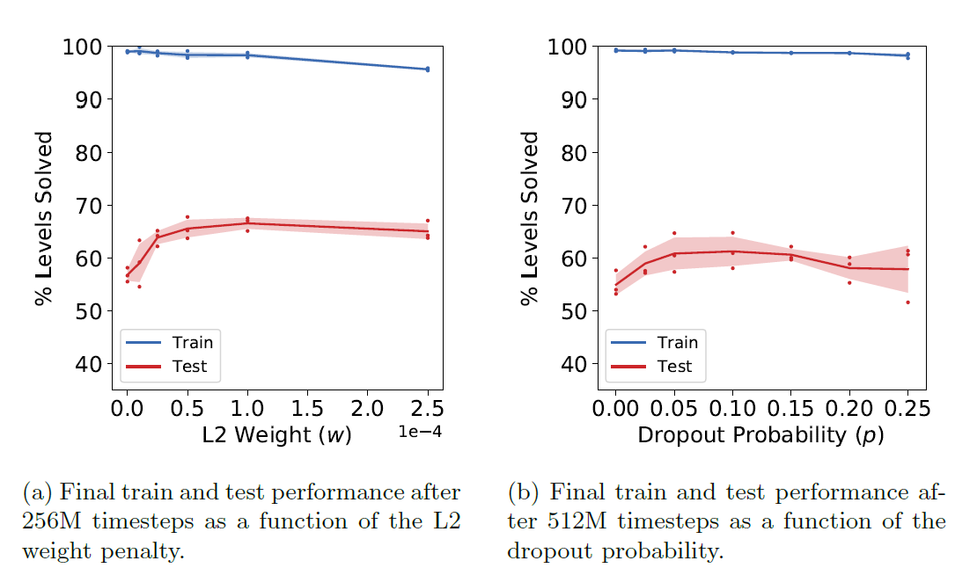
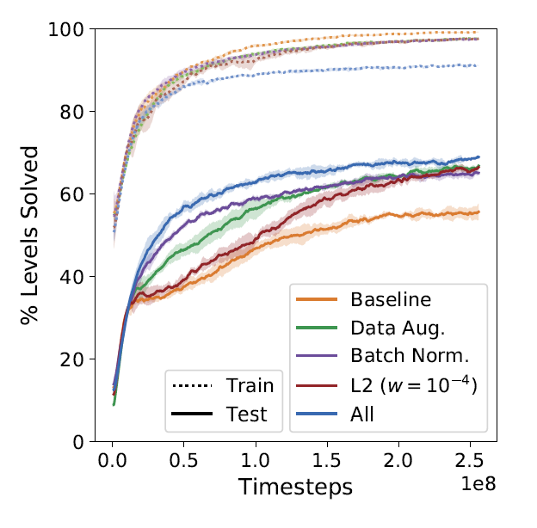
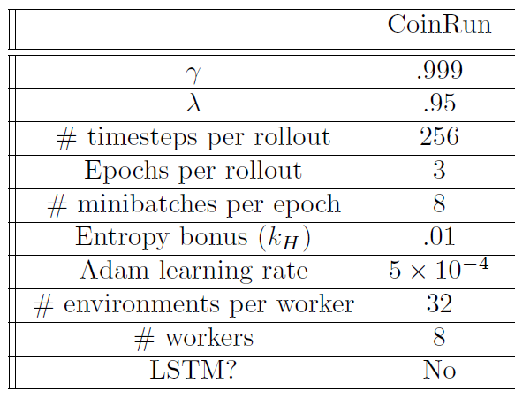
Result
Notes:
First from the graphs we can see optimal values obtained for dropout and L2.
And the final graph show +ev impact of all methods which is further improved with using all together.

Slide 8
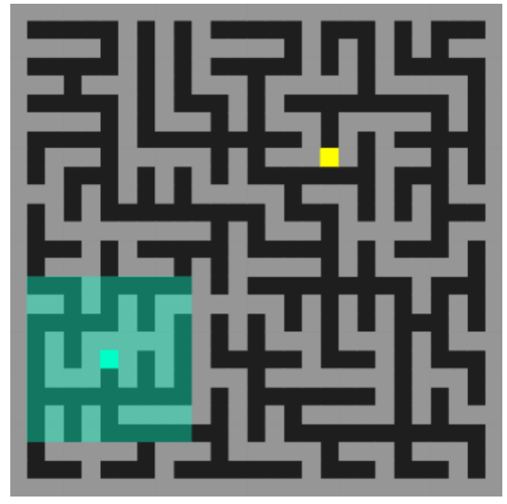
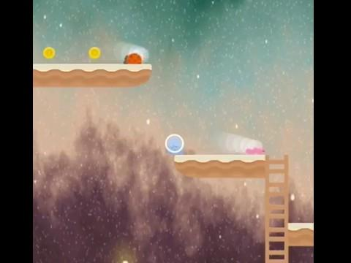
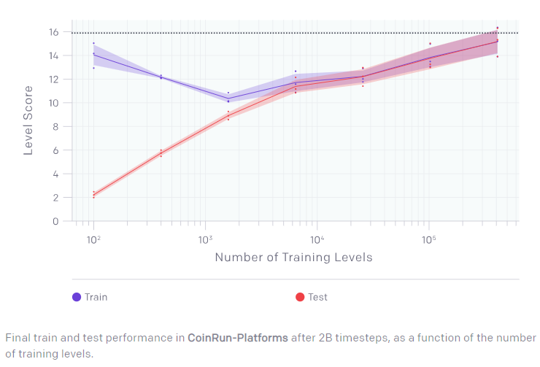
Additional Environments
IMPALA-CNN architecture followed by a LSTM
collecting all coins in a level gives an additional reward of 9
Notes:
To get the optimal number of training level required they tested with 3 games coinrun, coinrun-platform which is a little more complex than coinrun and maze game. All of them show optimal performance is gained after 250 games.

Slide 9
Gaps and Future Research
Future Research
Complexity of the environment can impact number of level required for good generalization.
LSTM could have increased the test performance in simple Coinrun also.
Limited Regularization and Architectures explored.
Investigate the relationship between environment complexity and the number of levels required for good generalization.
Impact of different recurrent architectures .
Explore ways to effectively combine different regularization methods.
Notes:
Maybe LTSM could increase the performance in coinrun. And limited regularization and architecture explored.
So for further study we can explore more regularization method impact and different architecture impact.
Also we can investigate the relationship between the environment complexity and the number of levels required for good generalization.

Slide 10
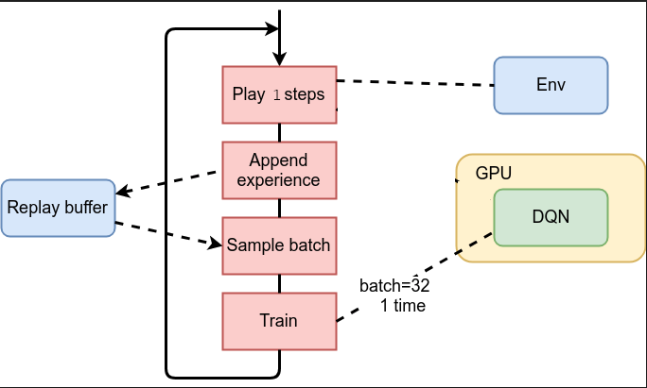
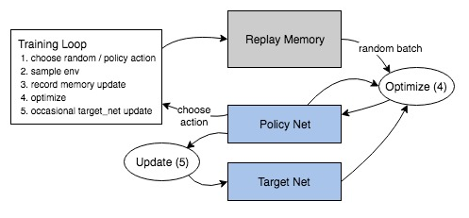
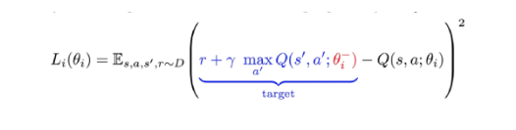
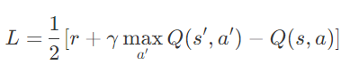
My Project : Apply Q-Learning (DQN)
Notes:
I will be implementing Q-Learning on this environment. More specifically Deep Q-Network where we use NN to approximate the value of all State and Action Pair instead of a large table.

Slide 11
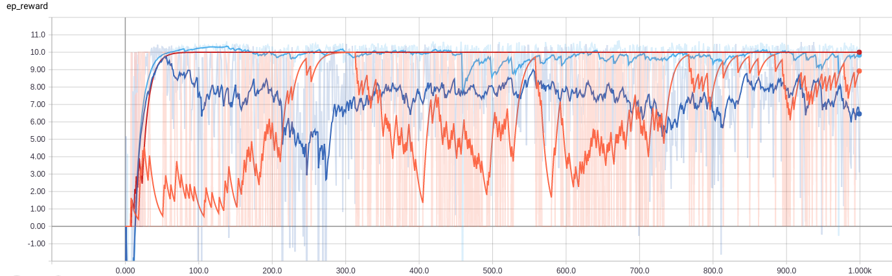
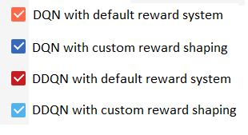

Slide 12
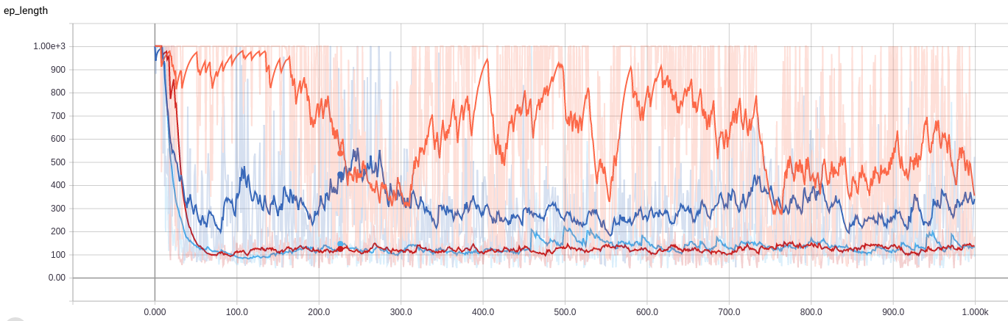

Slide 13
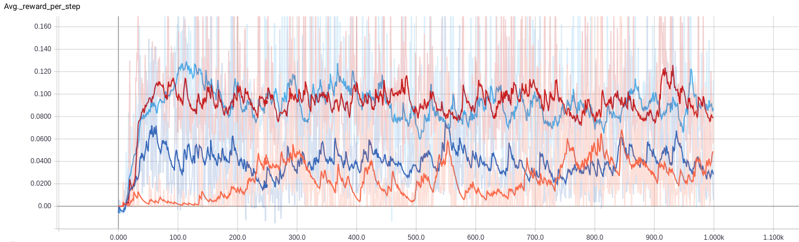

Slide 14


